Slide 1
Project 3
Housing Prices in Perth
Group Members
Yingzhen Wang
Shristi Bhattarai
Dashrath Bhandari
Sushil Baskota

Slide 2

PURPOSE OF PROJECT
To provide an overview of how the housing prices have changed over the past decade, highlighting any significant trends or patterns in the data also focus on five suburbs in perth with the highest sold prices and it will include a map with markers indicating the location and price of each property
To analyse out the factors thats affects the housing prices so that we can make the best decision while investing in real estate.

Slide 3
Resources and libraries
Python
Pandas
SQLite
Python Flask API
JavaScript
HTML

Slide 4
STEPS IN OUR DATA VISUALISATION
Data collection KAGGLE
Analyse data ( look at the missing information, check required information (rows/column)
Data cleaning
Check data type
Create database

Slide 5
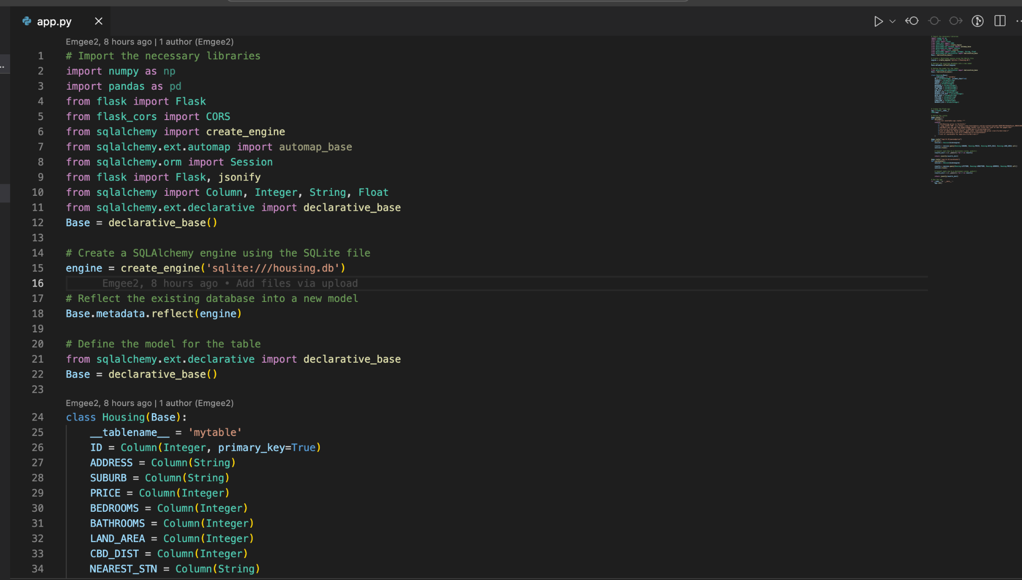

Slide 6
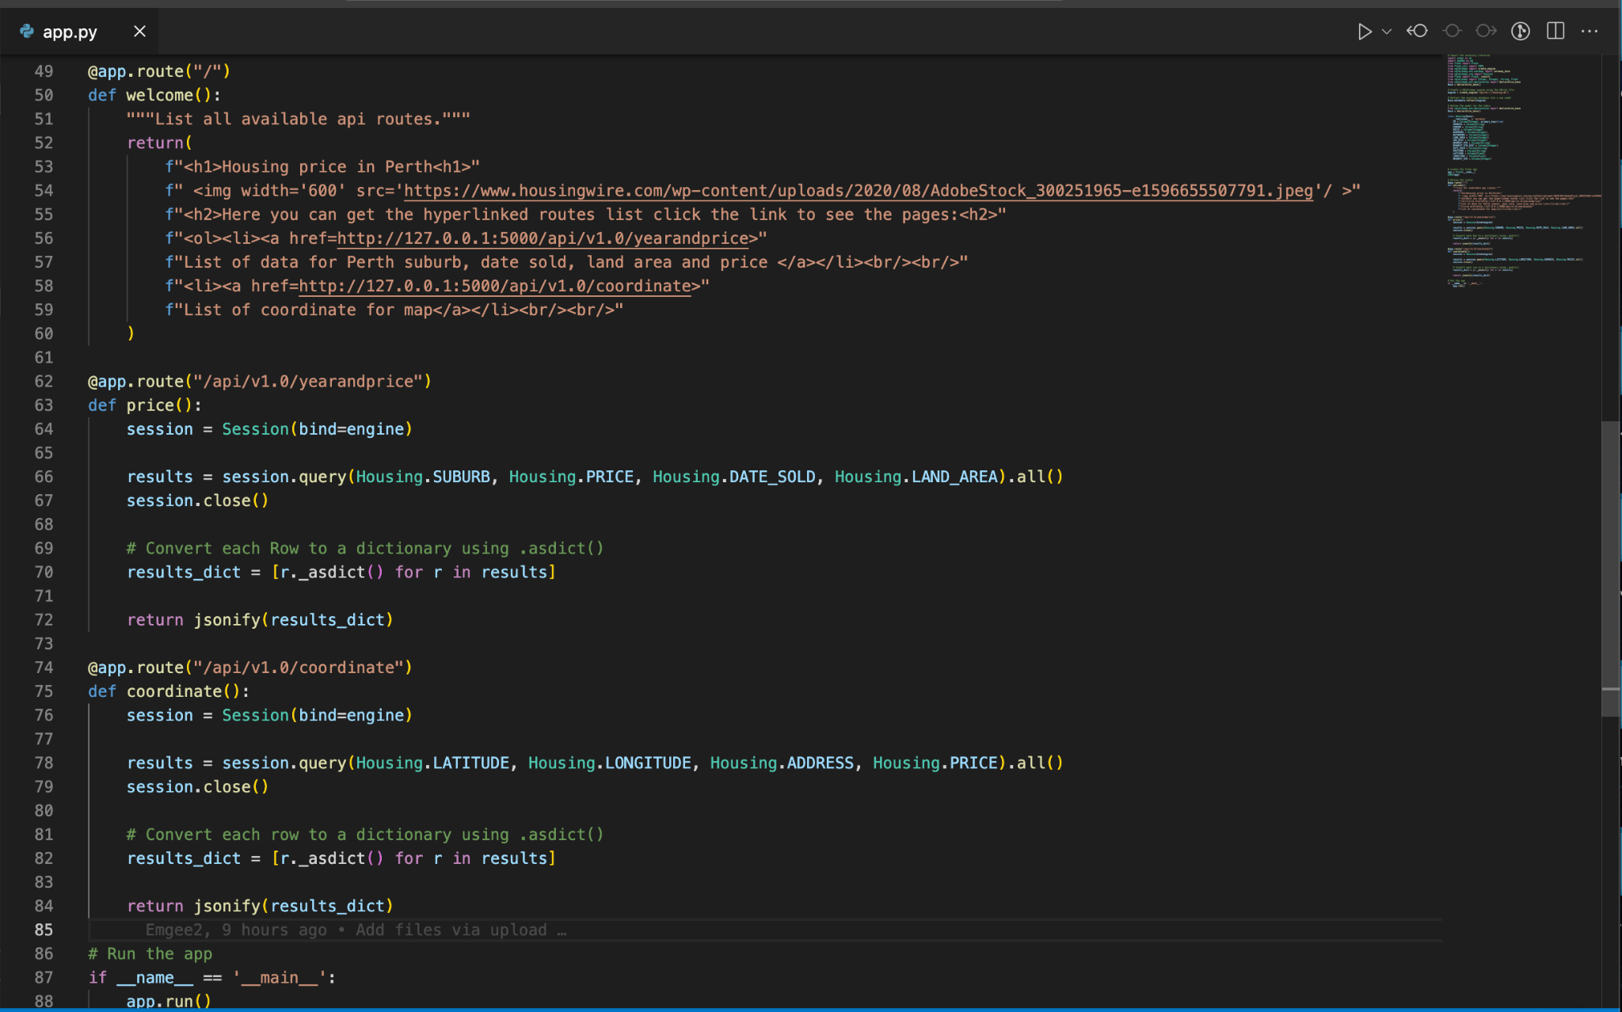

Slide 7
Data Visualization
Dashboard
Bar graph
Line graph
Leaflet
Maps

Slide 8
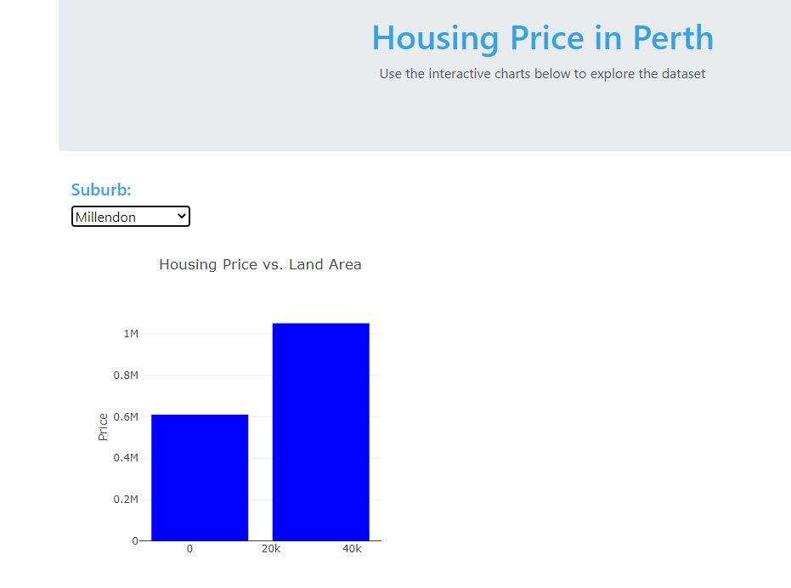
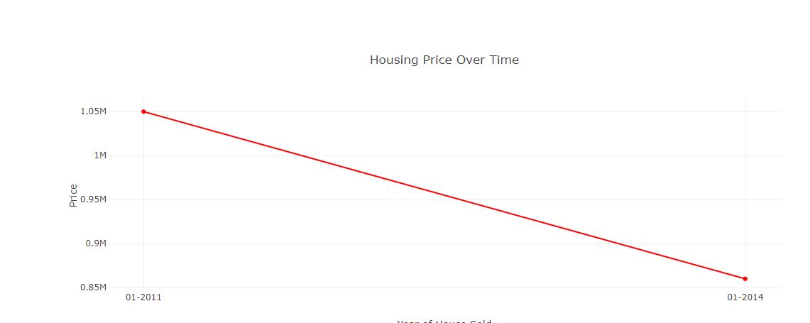
Images from the dashboard

Slide 9
Coding from Leaflet
Use D3 library
Use Font Awesome library to create home icon markers - plug in to JavaScript.
Popup address and price

Slide 10
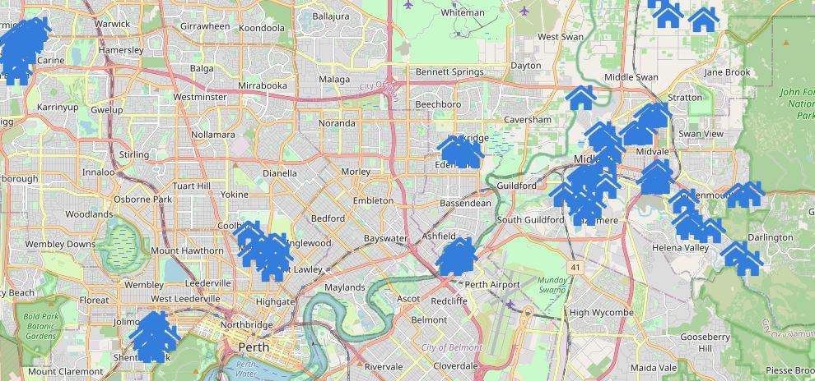
Images from the leaflet

Slide 11
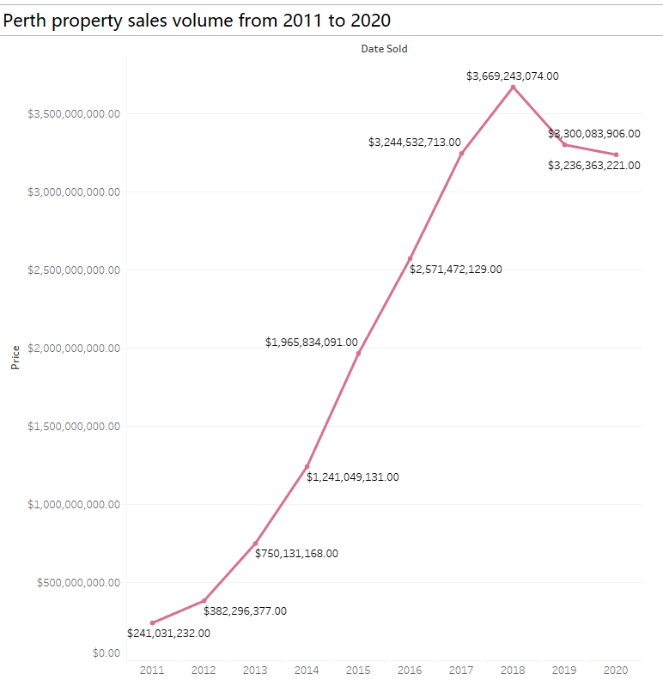

Slide 12
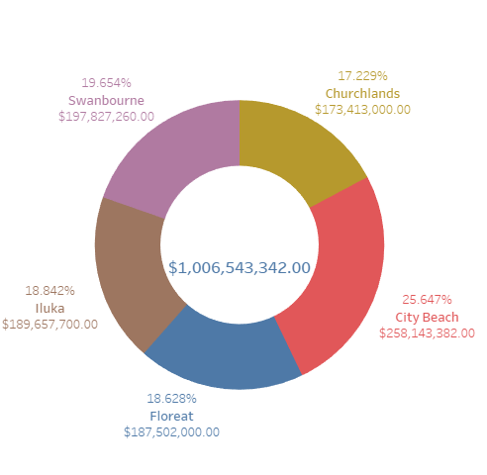

Slide 13
Conclusion:
Our analysis of housing prices in Perth from 2011 to 2020 shows some interesting trends and variations among different suburbs.
We found that the overall sales volume peaked in the mid-2010s and has been declining since then. Through the dashboard and visualization tools we created, we were able to gain a better understanding of the data and identify some patterns and outliers.
Our case study of five suburbs revealed that the housing markets in these areas vary significantly in terms of size and growth. While there could be many factors contributing to these differences, our analysis suggests that location, amenities, and market demand play a key role in shaping real estate prices.
We hope that this presentation has given you some insights into the housing market in Perth and the power of data analysis has helped in making right decisions.
Thank you for your attention

